Slide 1

Federated Learning and Data Privacy Protection

Slide 2

目录
CONTENTS
Foundations and Motivation of Federated Learning
01
02
Federated Learning Algorithms and System Design
03
Privacy Mechanisms and Attack Models in FL
04
Applications and Research Frontiers

Slide 3


YOUR LOGO
01
Foundations and Motivation of Federated Learning

Slide 4
Foundations and Motivation of Federated Learning
Definition: A distributed machine learning paradigm where data remains local, and only model updates (e.g., gradients or weights) are shared with a central server.
Why Federated Learning?
Data privacy regulations (e.g., GDPR, HIPAA)
Data silos (e.g., hospitals, banks)
Edge intelligence: computation on mobile/IoT devices

Slide 5


Federated Learning Types:
📱 Cross-Device Federated Learning
Definition: Involves a massive number of personal edge devices (e.g., smartphones, wearables, sensors) as clients in the federated learning process.
Characteristics:
Very large number of clients; only a small subset participates in each training round
Data is highly non-IID and personalized (heterogeneous)
Devices are resource-constrained (limited compute, memory, unstable connectivity)
🏥 Cross-Silo Federated Learning
Definition: Involves a small number of institutions or organizations (e.g., hospitals, banks, universities), each with centralized, high-quality datasets.
Characteristics:
Small number of reliable clients; each client has stable connectivity and compute power
Data is relatively consistent across silos
Easier to coordinate and schedule training

Slide 6
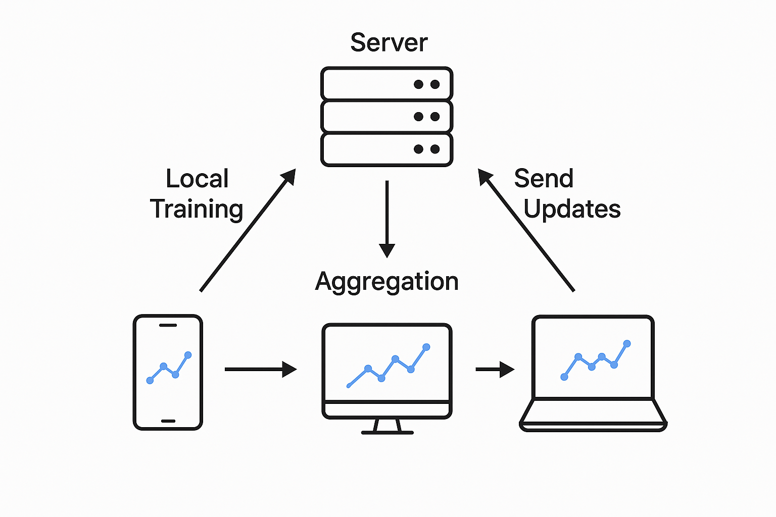
​​Key Components
Client: owns local data, trains model locally
Server: coordinates training, aggregates updates
Communication rounds: global aggregation cycle
This diagram shows the basic workflow of Federated Learning:
Multiple clients (like smartphones and laptops) train models locally without sharing raw data.
They send model updates to the central server.
The server aggregates the updates to create a new global model and distributes it back.
This loop repeats to enable privacy-preserving collaborative learning."

Slide 7
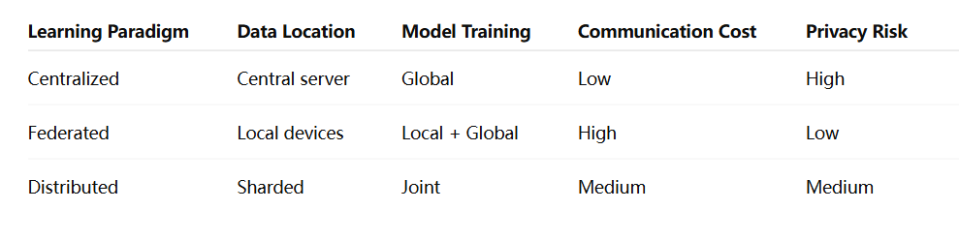
​​Comparison

Slide 8
YOUR LOGO
02
Federated Learning Algorithms and System Design

Slide 9

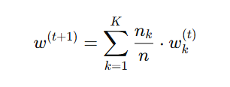
​​Core Algorithms
🧠 1. FedAvg (Federated Averaging)
Question: Can decentralized clients collaboratively train a shared model without sharing data?
Proposed by: McMahan et al., Google, 2017
Core Idea
Mathematical Expression
Each client trains locally for a few epochs
Clients send updated model weights to a central server
Server aggregates the weights using a weighted average
Let K be the number of clients, n_{k} the number of data points on client k,and The update rule is:

Slide 10
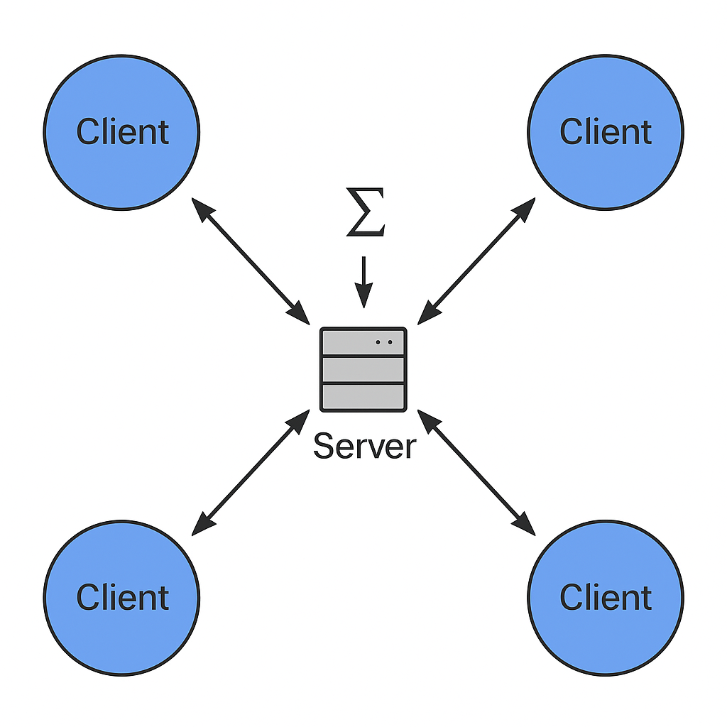
​​Core Algorithms
🧠 1. FedAvg (Federated Averaging)
Each client trains locally for a few epochs
Clients send updated model weights to a central server
Server aggregates the weights using a weighted average
This diagram shows: multiple clients train locally, send only model updates to the server, which aggregates them—typically by averaging—and sends the new global model back. Raw data never leaves the devices.

Slide 11

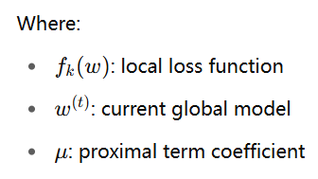
​​Core Algorithms
🧠 2. FedProx (Federated Proximal)
FedAvg can diverge when client data is non-IID
Solution: add a regularization term to constrain local updates near the global model
Core Idea
Mathematical Expression
Modify local objectives by adding a proximal term
Keeps client updates close to the global model
Each client solves:

Slide 12


​​Core Algorithms
🧠 3. FedNova (Normalized Averaging)
In FedAvg, different local epochs (or steps) introduce aggregation bias
Clients training more will dominate the global update
Core Idea
Mathematical Expression
Normalize client updates by their contribution to remove bias
Achieve fairness regardless of local training effort
The server update:

Slide 13
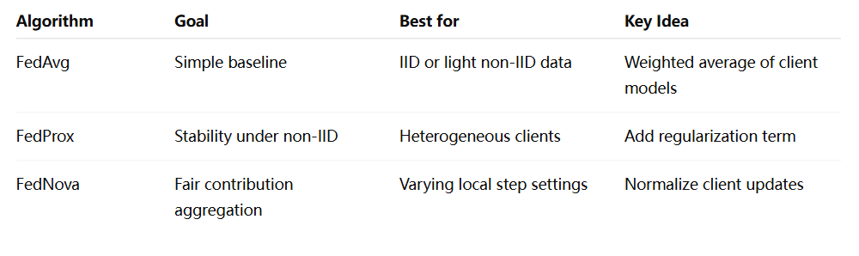
​​Core Algorithms
summary

Slide 14
​​System Architecture Considerations
The following will explain the key points of system architecture in federated learning from five aspects: core components→ architecture patterns→ communication mechanisms→ heterogeneity challenges→ engineering optimization
core components
architecture patterns
communication mechanisms
heterogeneity challenges
engineering optimization

Slide 15

core components
Client (Participant / Edge Device)
Server (Coordinator):
Stores local data (private)
Performs local training
Examples: smartphone, wearable, hospital server
Orchestrates training
Sends global model to clients
Aggregates local updates into new global model

Slide 16
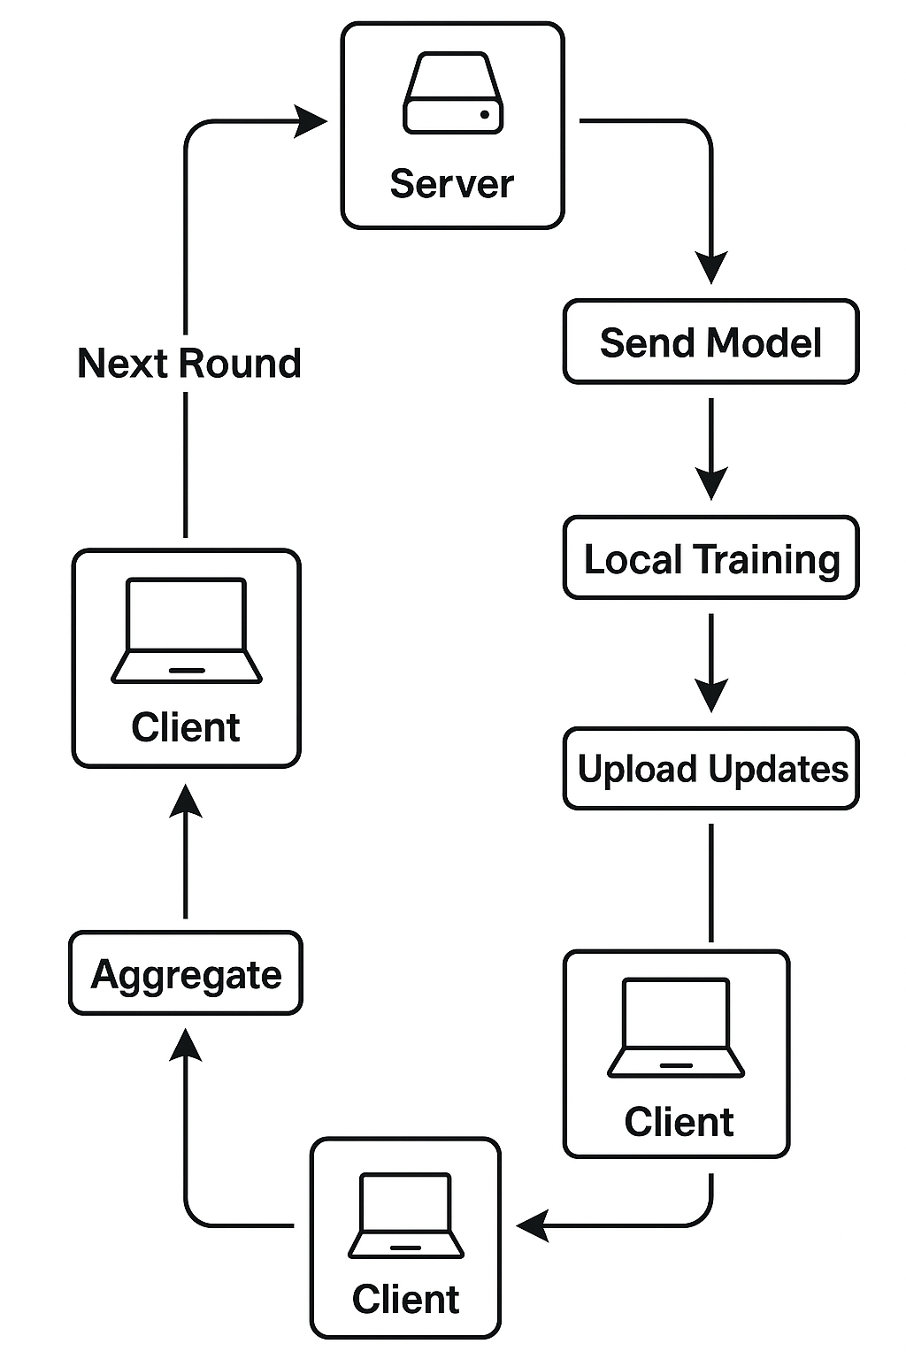
core components
This diagram shows one round of federated learning:
The server sends the global model → each client trains locally → uploads updates → the server aggregates them → and starts the next round.
Raw data stays on the client, ensuring privacy.

Slide 17
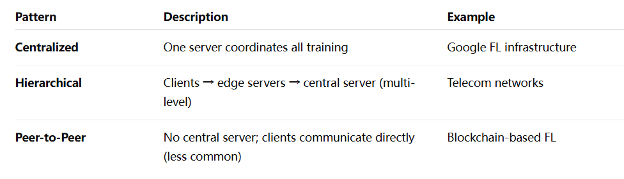
​​Architectural Patterns
thinking:Why would a telecom company prefer hierarchical FL?

Slide 18
​​Communication Protocols
Challenges:
Uplink bandwidth is limited
Devices may be offline or unreliable
Frequent model updates = heavy traffi
✅ Solutions:
Client sampling: Select a subset of clients per round (e.g., 10%)
Update compression:
Quantization (e.g., float32 → int8)
Sparsification (send top-k gradients)
Asynchronous updates: Let clients train/upload at different times

Slide 19
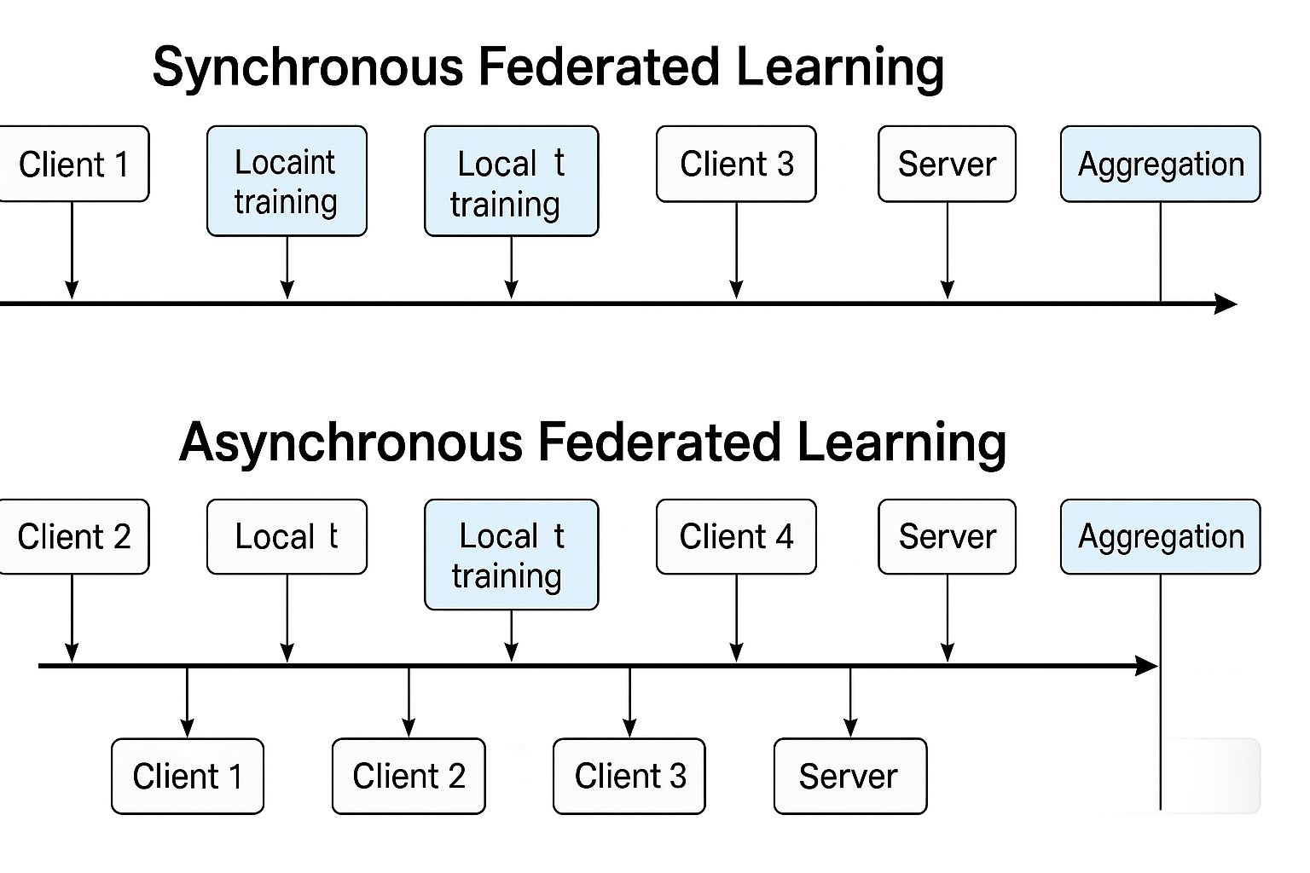
​​Communication Protocols
Two timelines:
Synchronous FL: wait for all clients per round
Asynchronous FL: update immediately when any client responds

Slide 20
​​System Heterogeneity
Solutions:
What varies among clients?
CPU, GPU, memory
Battery, connectivity
Dataset size and distribution (non-IID)
Client selection: filter by capacity or bandwidth
Weighted aggregation: based on data volume
Adaptive scheduling: allow more/fewer local epochs depending on client speed
Impacts:
Stragglers slow down training
Some clients may dominate aggregation (bias)
It's like managing a group project where some students have less time or fewer resources — how do you still move forward?

Slide 21
Engineering-Level Optimizations
Secure Aggregation: ensure server cannot see individual updates
Model personalization: local fine-tuning for better user experience
Fault tolerance: support dropout and resume
Device dropout detection: reconnect and reschedule

Slide 22
YOUR LOGO
03
Privacy Mechanisms and Attack Models in FL

Slide 23
​​Threat Models
In federated learning, although data is not uploaded, model updates may also leak privacy. We need to understand the attack methods in order to provide targeted protection.
Three common threat models：
Model Inversion Attack：The attacker uses the model’s outputs or parameters to reconstruct an approximate version of the original training data.
Membership Inference Attack (MIA)：The attacker tries to guess whether a specific data sample was used during training, based on how confident the model is.
Gradient Leakage：The attacker analyzes the gradients sent by a client and directly reconstructs the original input data, especially during early training.

Slide 24
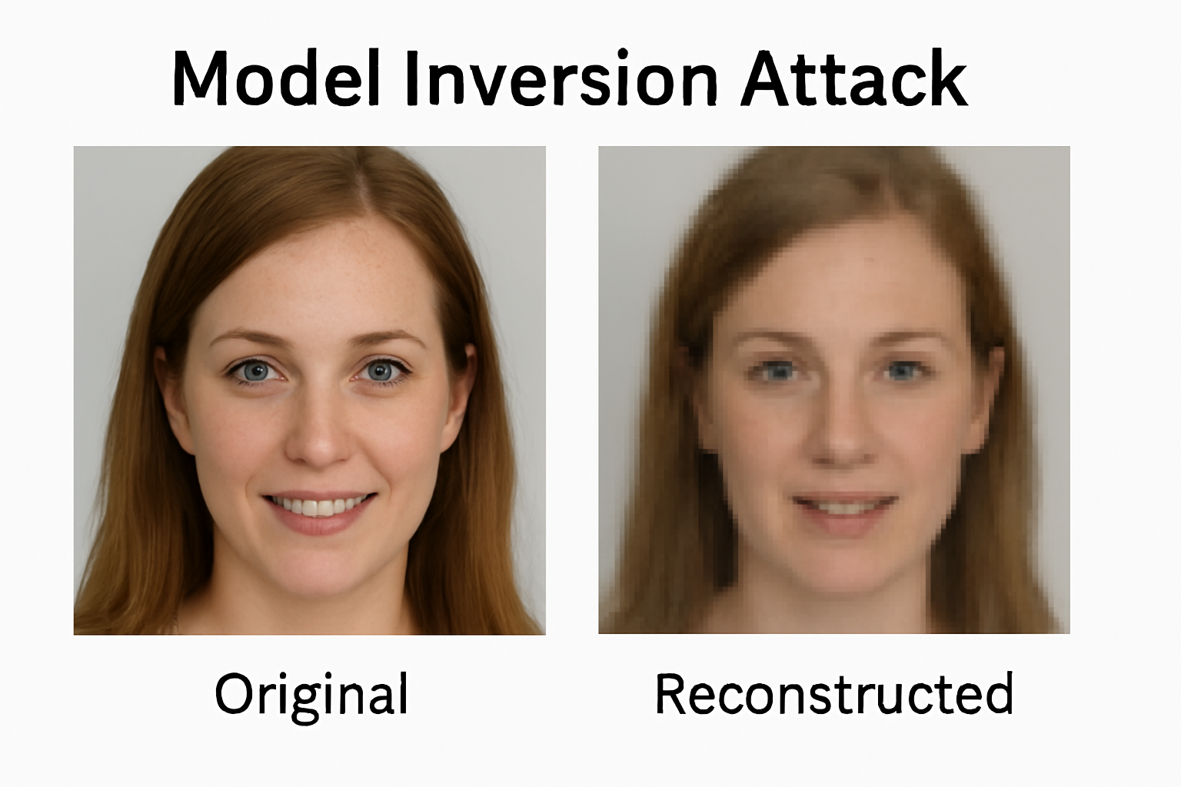
​​Threat Models
Model Inversion Attack：
Example:
If the model is trained on face images, the attacker might recover a blurry face from the shared model updates.

Slide 25
​​Threat Models
Membership Inference Attack
Example:
📌 Scenario：A hospital uses Federated Learning to train a pneumonia detection model on chest X-rays. Patient data stays local; only model updates are shared.
🎯 Attacker's Goal：Find out if Patient A’s X-ray was used in training.
How It Works
Attacker has Patient A’s image and model access.
Inputs the image and checks the confidence score.
Compares it to outputs for known non-training images.
If the model shows high confidence, Patient A likely contributed to training.
⚠Risk：Reveals private facts like diagnosis, test participation, or hospital visits.

Slide 26
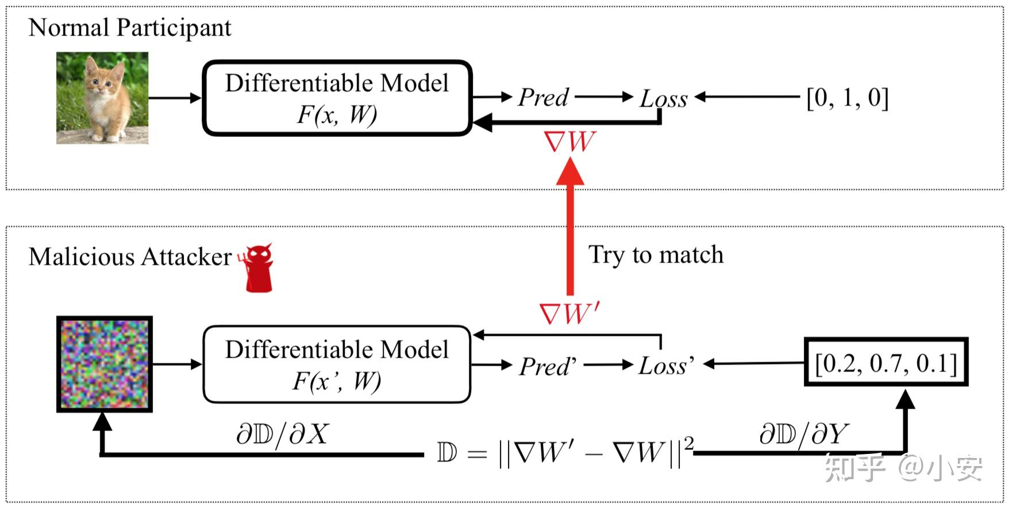
​​Threat Models
Gradient Leakage
Plain explanation:
The attacker analyzes the gradients sent by a client and directly reconstructs the original input data, especially during early training.
One-sentence summary:
Gradients, if unprotected, can “translate” directly into raw user data.

Slide 27
​​Privacy-Preserving Techniques
We have analyzed the model attacks above, and now we will explain the protection techniques
Four Main Privacy-Preserving Techniques：
Differential Privacy (DP) – “Blurring the view”
Secure Aggregation (SA) – “See the sum, not individuals”
Homomorphic Encryption (HE) – “Computing in a locked box”
Secure Multi-Party Computation (SMC) – “Cooperate without revealing”

Slide 28
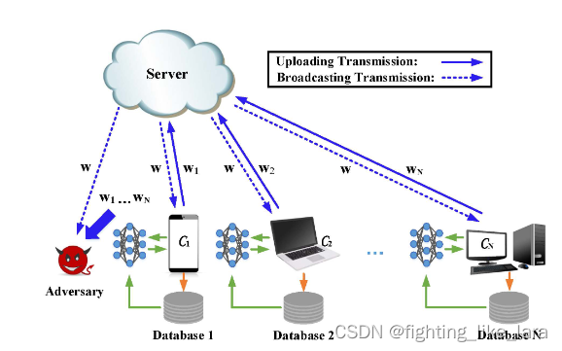
​​Differential Privacy (DP)
Concept:
Ensures that the server can only see the aggregated updates from clients, not individual ones.
How it works:
Each client encrypts its model updates in such a way that the server can decrypt only the sum of all updates. Individual contributions remain hidden.
Use case:
Federated learning across user devices for common models (e.g., Gboard word suggestions).

Slide 29
​​Secure Aggregation (SA)
Concept:
Ensures that the server can only see the aggregated updates from clients, not individual ones.
How it works:
Each client encrypts its model updates in such a way that the server can decrypt only the sum of all updates. Individual contributions remain hidden.
Pros:
Cons:
No impact on model accuracy
Efficient for standard federated learning
Only supports additive operations (like FedAvg)
More complex communication protocol
Use case:
Federated learning across user devices for common models (e.g., Gboard word suggestions).

Slide 30
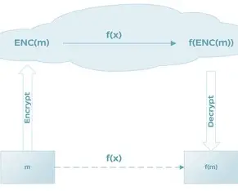
​​Homomorphic Encryption (HE)
Concept:
Allows computations to be performed directly on encrypted data—no need to decrypt during training.
How it works:
The client encrypts the data/model updates and sends them to the server. The server performs operations on the encrypted values and returns the encrypted result.
Use case:
Sensitive fields like finance or defense where data must never be exposed—even during processing.

Slide 31
​​Homomorphic Encryption (HE)
Concept:
Multiple participants jointly compute a function without revealing their private inputs to each other.
How it works:
Each party splits its input into shares and exchanges them in a way that allows the final result to be computed collaboratively—without anyone learning the others’ data.
Pros:
Cons:
Strong privacy guarantees
Suitable for inter-institutional collaboration
High communication and computation overhead
Complex to implement at scale
Use case:
Cross-silo federated learning (e.g., between banks or hospitals).

Slide 32
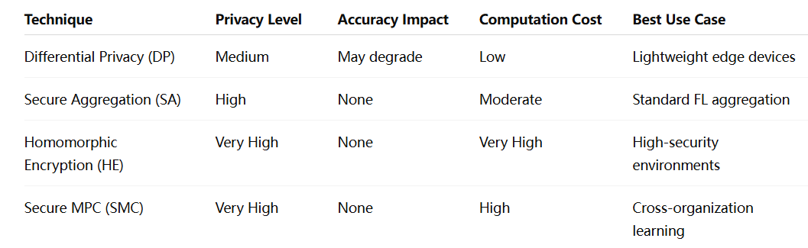
​​Summary Comparison

Slide 33
YOUR LOGO
04
Applications and Research Frontiers

Slide 34
​​Real-World Applications of Federated Learning
Healthcare
📌 Problem:
Medical data is highly sensitive (e.g., CT scans, health records)
Hospitals can’t easily share data due to privacy laws (e.g., HIPAA, GDPR)
Individual hospitals often have limited data for training robust models

Slide 35
​​Real-World Applications of Federated Learning
Healthcare
💡 How FL Helps:
Each hospital trains the model locally on its own data
Only model updates (weights/gradients) are sent to a central server
The server aggregates updates and shares the improved model back
No raw patient data ever leaves the hospital

Slide 36
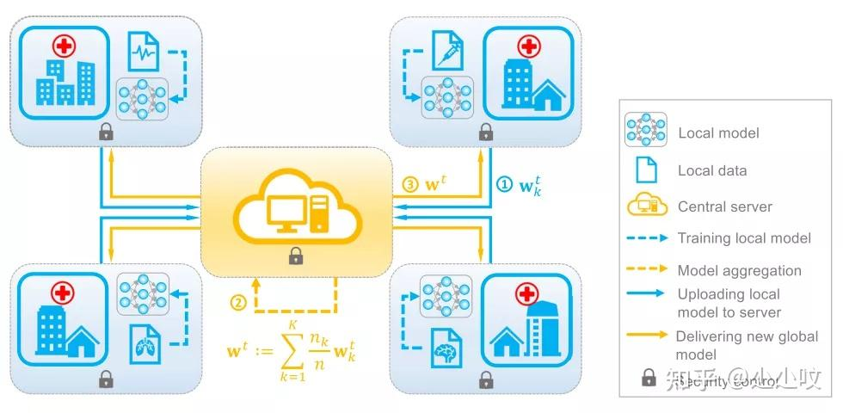
​​Real-World Applications of Federated Learning
Healthcare
💡Real Case:
COVID-19 diagnosis collaboration (2020) across multiple hospitals in the US and UK
Used FedAvg to train a shared model on CT scans
Added Differential Privacy (DP) and Secure Aggregation (SA) to protect patient data

Slide 37
​​Real-World Applications of Federated Learning
Finance
📌 Problem:
💡 How FL Helps:
Fraud detection often requires cross-bank collaboration
Banks cannot share user data due to privacy and competition concerns
Each bank trains a model on its own transaction data
Model updates are securely aggregated to build a global fraud detection model
No raw financial data is exchanged

Slide 38
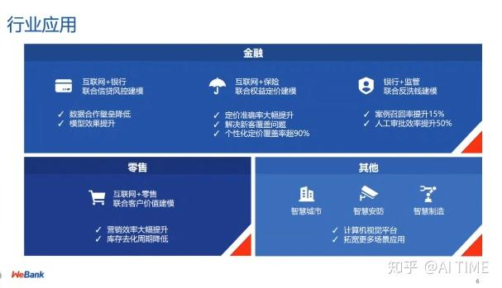
​​Real-World Applications of Federated Learning
Finance
💡Real Case:
Ant Group (Alibaba): vertical FL used for joint fraud detection
Bank A has transaction logs
Bank B has customer profile data
Used Vertical FL and Secure Multi-Party Computation (SMC)

Slide 39
​​Real-World Applications of Federated Learning
Smart Devices：
📌 Problem:
💡 How FL Helps:
Edge devices (phones, smartwatches, cars) generate massive amounts of data
Uploading all data to the cloud is inefficient and raises privacy concerns
Devices perform on-device model training (e.g., for speech or activity recognition)
Only model updates are shared with the central server
Devices retain all private user data locally

Slide 40
​​Where is FL going next?
📌
Classical federated learning, such as FedAvg, does not solve all real-world problems
💡 The following introduces the current research hotspots and technology trends
1）Personalized Federated Learning
Problem:
Clients often have non-IID data (data distributions differ significantly), so a single global model may perform poorly on local tasks.
💡 Research Direction:
Fine-tune the global model locally for personalization
Or apply meta-learning to build models that quickly adapt to each client

Slide 41
​​Where is FL going next?
1） Personalized Federated Learning
Representative Methods:
pFedMe: adds regularization to balance global and personalized objectives
FedPer: shares bottom layers, personalizes top layers
Per-FedAvg / MetaFed: meta-learning based personalization
Applications:
Input method prediction tailored to each user’s typing habits
Personalized health monitoring (e.g., heart rate models)
analogy: “A single prescription doesn’t fit all patients—same with models.”

Slide 42
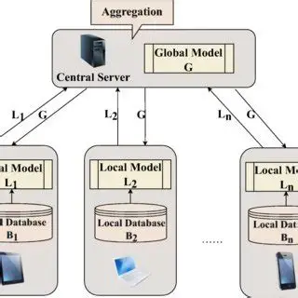
​​Where is FL going next?
2） Federated Transfer Learning (FTL)
Problem:
Participants have different feature spaces (e.g., hospital has images, insurance has tabular data), but want to collaborate.
Research Direction:
Apply transfer learning across organizations with different data formats
Share knowledge via representation alignment or embedding spaces

Slide 43
​​Where is FL going next?
2） Federated Transfer Learning (FTL)
Representative Methods:
Joint embedding techniques
Representation alignment strategies (e.g., FedTransfer)
Applications:
Medical + insurance companies building joint risk models
Banks + social networks creating cross-domain user credit scores
analogy: “Speaking different languages? Transfer learning is the translator.”

Slide 44
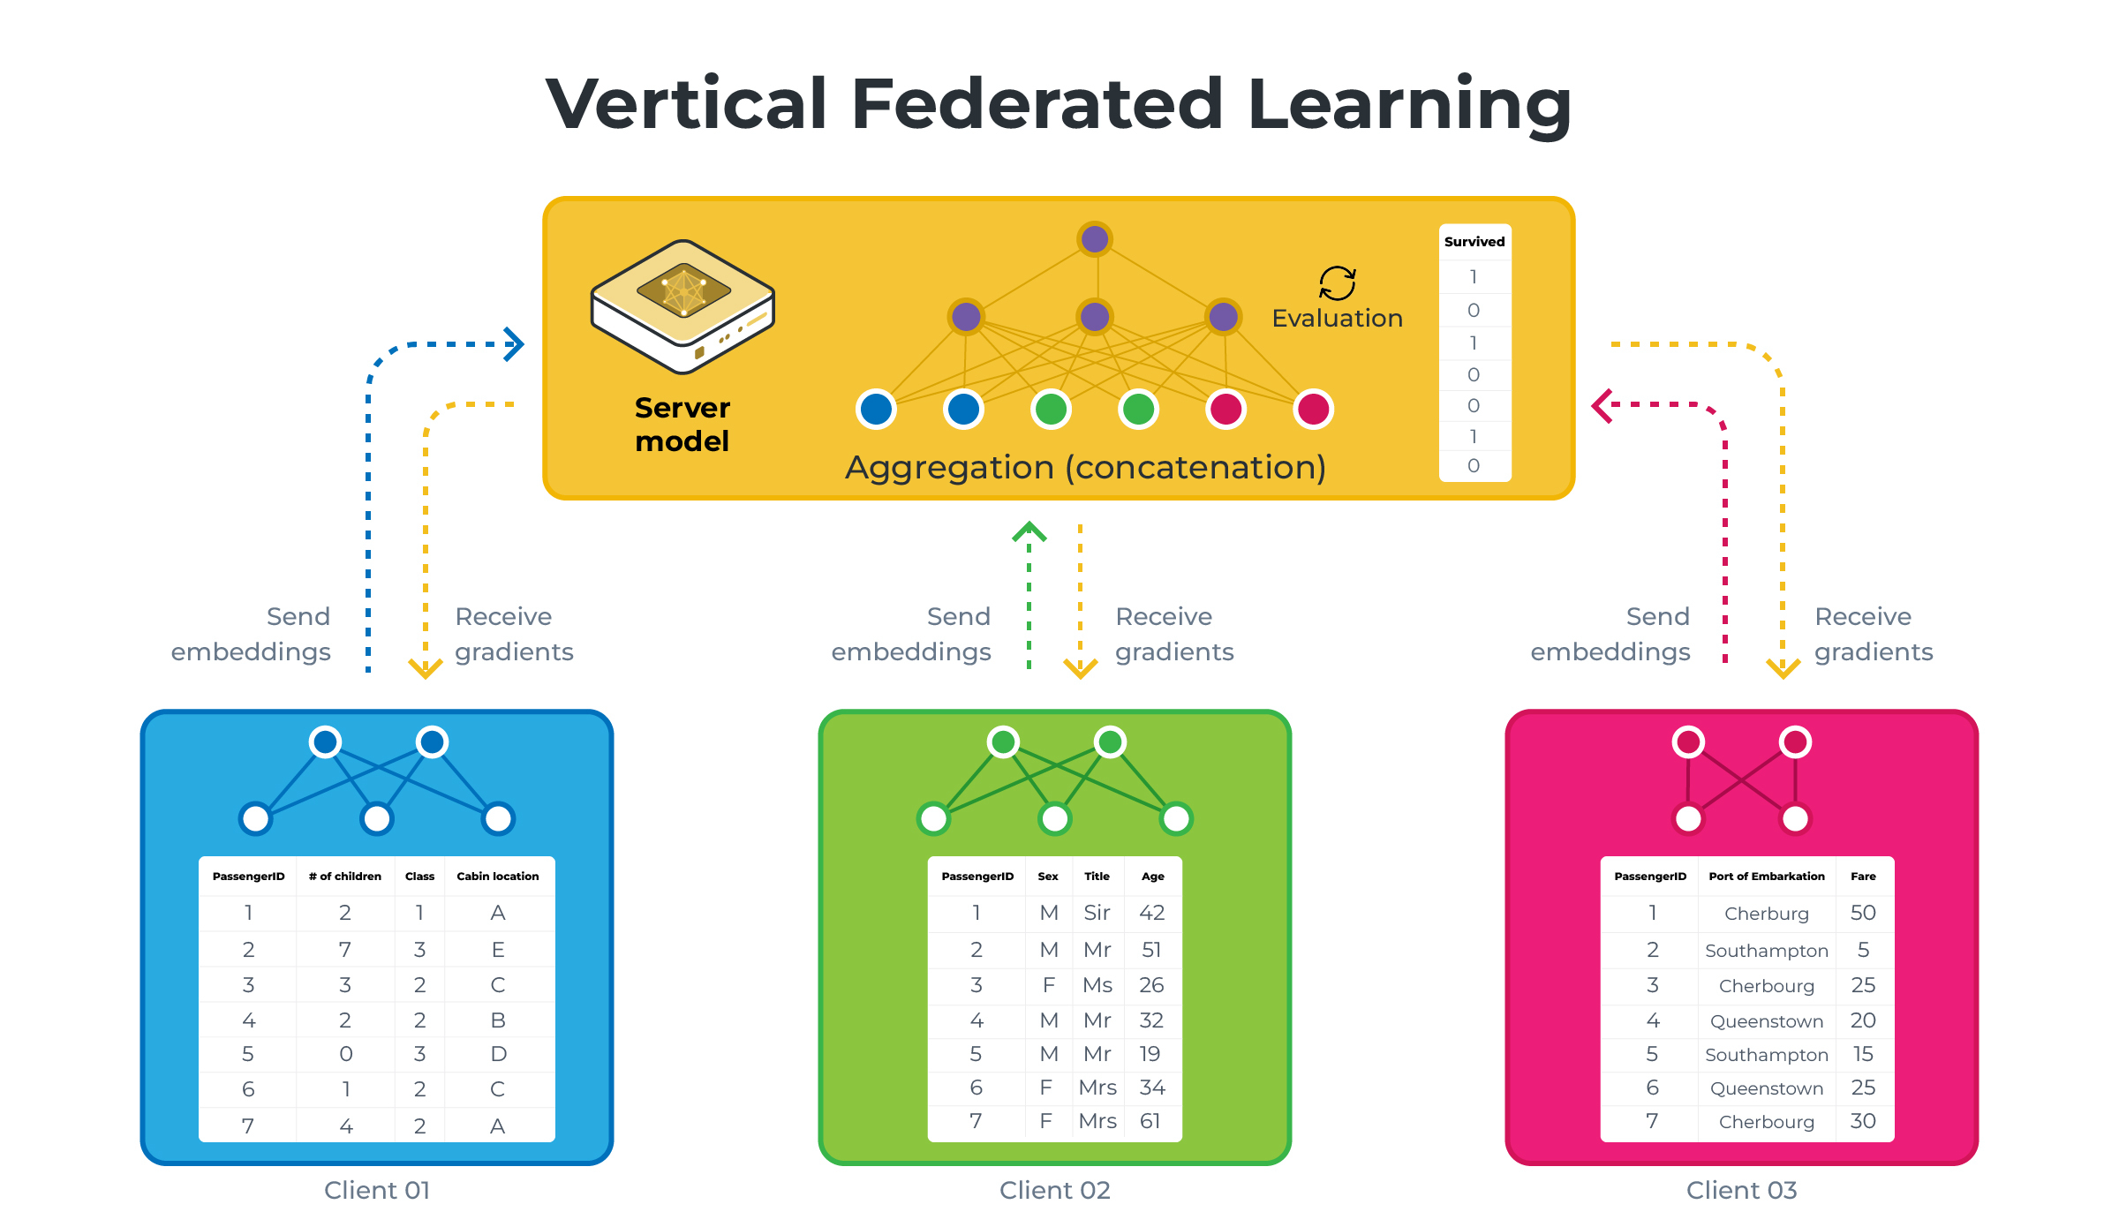
​​Where is FL going next?
3）Vertical Federated Learning (VFL)
Problem:
Different institutions hold different features of the same users (e.g., Bank A has income; e-commerce has purchase history)
Research Direction:
Apply transfer learning across organizations with different data formats
Share knowledge via representation alignment or embedding spaces

Slide 45
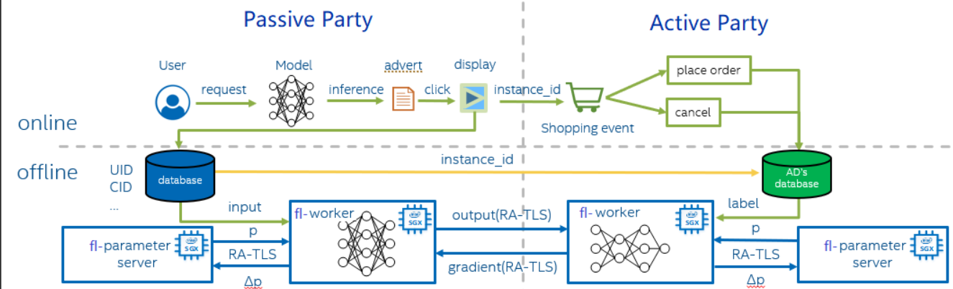
​​Where is FL going next?
3） Vertical Federated Learning (VFL)
Representative Methods:
FATE (open-source FL framework supporting VFL)
SecureBoost: tree-based VFL model
Applications:
Bank + e-commerce collaboration on credit scoring
Hospital + pharma company for drug personalization

Slide 46
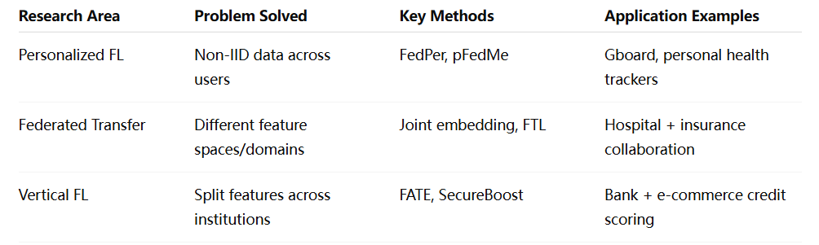
​​Where is FL going next?

Slide 47
THANK YOU

